Slide 1
CHAPTER 6
SOILS,NATURAL VEGETATION AND WILDLIFE RESOURCES OF ETHIOPIA AND THE HORN

Slide 2
CONTENTS
6.1 Introduction
6.2. Soil – Formation
6.3. Major Soil Types in Ethiopia
6.4. Soil Degradation & Control Measures
6.5. Natural Vegetation of Ethiopia
6.6. Wild Life/Animals in Ethiopia

Slide 3
Chapter's Objectives
At the end of this chapter you will be able to;
>>Identify major soil types of Ethiopia
>>Understand soil degradation and conservation measures
>> Describe the distribution of natural vegetations in Ethiopia
>> Explain the significance of wildlife resources of Ethiopia

Slide 4
6.1 Introduction
The past geological process and varied climatic events ensued Ethiopia to have varied soil and biological diversity. The formation and spatial variabilities of soils in Ethiopia is largely related to topographic and climatic factors, parent material (rocks) and land use. Different parts of Ethiopian regions experiences. Likewise, the distribution of wildlife and natural vegetation in Ethiopia and the Horn is controlled by many factors important among which are climate, soil types, drainage, etc. Natural vegetations are vital for human beings in many ways. Plants can provide shelter, food, source of fuel, pasture and grazing, raw material for industries. Ethiopia possesses unique and characteristic fauna and flora with a high level of endemicity. However, manmade as well as natural problems are threatening their availability and distribution.

Slide 5
6.2. Soil – Formation
Soil formation is a long-term process. It could take several thousands of years to form a single stratum of soil.
As it is a complex mixture of several constituents, its formation is also more complex.
The formation of a particular type of soil depends on parent material, climate, topography, living organism and time.

Slide 6
cont......
Weathering disintegrates the inorganic substances (rocks) of soils. It is the breakdown of rocks at the Earth’s surface, by the action of rainwater, extremes of temperature, and biological activity.
There are three types of weathering involving in soil formation. These are:
1) Mechanical (physical) weathering.
2) Biological weathering.
3) Chemical weathering
Notes:
Weathering: The physical disintegration and chemical decomposition of earth material or near earths surface.

Slide 7
1) Mechanical (physical) weathering.
Differential stresses due to heating and cooling or expansion of ice break the rock.
Abrasion(erosion by friction) due to water containing sediment or wind carrying debris is another type of physical weathering.

Slide 8
2)Biological weathering
Involves the weakening and subsequent disintegration of rock by plants, animals and microbes. Roots of plant can exert pressure on rock. Although the process is physical, the pressure is exerted by a biological process (i.e., growing roots).
Microbial activity breaks down rock minerals by altering the rock’s chemical composition, thus making it more susceptible to weathering.

Slide 9
3) Chemical weathering
Chemical weathering involves the modification of the chemical and mineralogical composition of the weathered material.
The most common chemical weathering processes are hydrolysis, oxidation, reduction, hydration, carbonation, and solution.
Alluvial soils: are soils which are transported from one place to another by agents like running water.

Slide 10
properties of soils
Soils have two basic properties:
1)Physical properties
Soil physical properties are influenced by composition and proportion of major soil components. Properties such as texture, structure, porosity etc. are categorized under physical soil properties.
These properties affect air and water movement in the soil, and thus the soil’s ability to function.

Slide 11
cont...
2)Chemical Properties
Soil chemistry is the interaction of various chemical constituents that takes place among soil particles and in the water retained by soil.
Soil properties like availability of minerals, electrical conductivity, soil pH, etc. Soil chemical properties affect soil biological activity and indirectly the nutrient dynamics.

Slide 12
Major Soil Types in Ethiopia
Soils of Ethiopia are basically derived from crystalline, volcanic and Mesozoic sedimentary rocks. One can therefore, say that some of the soil divisions in the country are based on the geologic structure. However, it should be born in mind that, there are soils formed due to long waited deposition of sediments.
FAO has identified 18 soil associations in Ethiopia at scale of 1:2,000,000. Out of the major soils, 11 soil associations cover about 87.4 percent of the land area. The six major groups of soils in Ethiopia are discussed under the following points:
            1. Nitosols and Acrisols
            2. Vertisols
            3. Lithosols, Cambisols and Regosol
            4. Xerosols, Yermosols and Solanchaks
            5. Fluvisols
            6. Luvisols

Slide 13
1. Nitosols and Acrisols
Nitosols develop on gently sloping ground. Their parent materials include trap series volcanics,volcanic ash, and even metamorphic rocks.
They are basically associated with highlands with high rainfall and they were, probably, formed on forest covered areas originally.
Due to the high rainfall, there is considerable soil leaching which makes the nitosols to be poor in soluble minerals like potassium, calcium etc. And rich in non-soluble minerals like iron and aluminum.

Slide 14
cont...
The reddish-brown color of these soils is because of high concentration of iron (ferric) oxides due to leaching. But they are now widely found on cultivated areas and on mountain grasslands.
Nitosols are dominantly found in western highlands (Wellega), southwestern highlands (Kaffa, Illuababora), Southern highlands, Central highlands, and Eastern highlands.

Slide 15
cont...
Acrisols are one of the most inherently infertile soils of the tropics, becoming degraded chemically and organically very quickly when utilized.
Acrisols have very low resilience to degradation and moderate sensitivity to yield decline. In Ethiopia, it has lost most of the base nutrients and are characterized by low productive capacity.
Acrisols are found along with nitosols mostly in some pockets of southwestern highlands of Ethiopia where there is high rainfall.

Slide 16
2. Vertisols
Vertisols are heavy clay soils with a high proportion of swelling clays when wet, and cracks when dry. These soils are extremely difficult to manage (hence easily degraded), but has very high natural chemical fertility.
Vertisols mostly develop on volcanic plateau basalt, trachyte and pyroclastic materials, sedimentary rocks, colluvial slopes and alluvial plains they are also soils of highlands and moderate climates.
In Ethiopia, they are commonly found in parts of Northwestern, Central and Southeastern highlands (especially in Gojjam, Shewa, Arsi, Bale and central Hararghe).

Slide 17
3. Lithosols, Cambisols and Regosol
These soils are mostly found in rugged topography and steep slopes. There is little evidence of pedogenic processes (soil forming processes). As a result, they are young, shallow and coarse textured and so have low water holding capacity. In addition, they are found in areas of low rainfall.
They are, in most cases, left under the natural plant cover and used for grazing. These soils are found in different parts of rugged and steep slopes of Central Highlands, on the Rift Valley Escarpments and highlands in of western Hararghe. Regosol and Lithosols are also found in the Danakil and eastern Ogaden.

Slide 18
4. Xerosols, Yermosols and Solanchaks
These are soils of desert or dry steppe soils majorly available in arid and semiarid areas. Though ,the degree may vary, desert soils are characterized by high salt content and low organic content, because of the scanty vegetation. Generally speaking, these soils have poor humus content and nitrogen, but are rich in phosphorus and potash and can be very fertile if irrigated.
Xerosols are soils of the deserts, has low organic content. These soils are extremely subjected to wind erosion and concentration of soluble salts. Yermosols are even drier and more problematic than Xerosols.
Solanchaks are saline soils which develop in areas of high evaporation and capillary action. In Ethiopia, Xerosols are found in Ogaden and northeastern escarpments, whereas the Yermosols and Solonchaks cover the Ogaden and Afar plains. The Solonchaks are majorly located in salty plains of Afar.

Slide 19
5. Fluvisols
Fluvisols develop on flat or nearly flat ground, on recent alluvial deposits. These soils are associated with fluvial (river), marine (sea) and lacustine (lake) deposits.
These are soils formed due to deposition of eroded materials from highlands. The deposition takes place in depressions, lower valleys and lowlands. Lower regions of rivers like Omo,Awash, Abay and the plains of Akobo and Baro Rivers are home for fluvivsols.
Fluvisols are highly variable, but much prized for intensive agriculture because:
>>they develop on flat ground, deposition sites, they are associated with rivers and ground water, making them important for large-scale irrigation.
➢ >>they are fertile and their fertility is always renewed as a result of deposition of new soil materials.

Slide 20
6. Luvisols
Luvisols develop mainly in areas of wet and dry seasons occur in alternation. Where leaching is not very high, they are found in association with nitosols.
Have good chemical nutrients and they are among the best agricultural soils in the tropics. So, they are intensively cultivated.
In Ethiopia, places with luvisols include Lake Tana area, parts of Northern, Central and Eastern Highlands and Southern lowlands.

Slide 21
6.4. Soil Degradation & Control Measures
Soil degradation is defined as a change in any or all of the soil status resulting in a diminished capacity of the ecosystem to provide goods and services. It could also be the deterioration of the physical, chemical and biological properties of soil.
There are three major types of soil degradation. These are:
1. Physical Degradation: refers to the deterioration of the physical properties of soil. This includes: A. Compaction B. Soil erosion
2. Biological Degradation:Reduction in soil organic matter content, decline in biomass carbon, and decrease in activity and diversity of soil fauna are ramifications of biological degradation.
3. Chemical Degradation: Nutrient depletion is a major cause of chemical degradation.

Slide 22
Causes of soil degradation
Soil degradation may result from natural and human-induced causes.
Topographic and climatic factors such as:
steep slopes.
frequent floods and tornadoes.
storms and high-velocity wind.
high intensity rains and drought in dry regions are among the natural causes.
Deforestation and overexploitation of vegetation,Overgrazing, indiscriminate use of agrochemicals and lack of soil conservation practices, and over extraction of ground water are some anthropogenic(influence of human beings) causes of soil degradation.

Slide 23
Soil Erosion Control Measures
Since erosion is a natural process, it cannot be prevented. But it can be reduced to a maximum acceptable level or soil loss tolerance.
We have two major soil erosion control mechanisms. These are:
I. Biological Control measures: These types of soil erosion control mechanisms include vegetative strips, plantation, and reforestation. Biological controls can prevent splash erosion, reduces the velocity of surface runoff, increases surface roughness.
II. Physical control measures:
Physical measures are used to control the movement of water and wind over the soil surface. The major types of physical erosion control measures commonly applied in Ethiopia includes:
>>terracing, check dams, gabion, trenches, contour ploughing, soil bunds etc.

Slide 24
6.5. Natural Vegetation of Ethiopia
Natural vegetation refers to a plant cover that develops with little or no human interference. It can also be seen as any original plant cover grown in an area.
Its distribution on the surface of the earth is uneven majorly controlled by factors such as climate, soil types, drainage, etc.
Natural vegetations are vital for human beings in many ways. Plants can provide shelter, food, source of fuel, pasture and grazing, raw material for industries, source of timber and non-timber products.
The other uses include moderating effect on local climate, as home of wild life, medicinal values, minimizing soil erosion etc.
Notes:
xeromorphic plants: plants which are adapted to drought and high temperatures.

Slide 25
Major Natural Vegetation Types of Ethiopia
Taking altitude into consideration it is possible to broadly classify the vegetation belts of Ethiopia into the following five groups.
1. Afro-alpine and sub-afro alpine Region
2. Forest Region
3. Woodland Savannah Region
4. Steppe Region
5. Semi-desert Region

Slide 26
1. Afro-alpine and Sub-afro alpine Region
The Afro-alpine region is found at very high altitudes (4,000 – 4,620 m).
The annul precipitation which ranges between 800 and 1,500 mm, is mostly in the form of sleet or snow.
Temperature records of 0^C and below are widely experienced in these ecosystems.
Soils in this area are mostly shallow and eroded. The Bale and Semein mountains are typical examples of afro-alpine vegetations.

Slide 27
cont...
Compared to the Afro-alpine, the Sub-afro-alpine region is found at a lower elevation, roughly between 3,300 and 4,000 meters.
Vegetation in the Afro-alpine region consists of tussock grasslands, scrub, scattered mosses and lichens.
while the Sub-afro alpine region is dominated by woodland, often degraded to scrub stages and also wet grasslands. Lobelia rhynchopetalum (giberra) and Erica arborea (Asta) are some of the dominant species in the Afro-alpine and Sub-afro alpine regions respectively.

Slide 28
2. Forest Region
Forest is a complex ecosystem consisting predominantly of trees that shield earth and support numerous life forms .
In any geographical region, environmental factors such as climate, soil types, topography and elevation determine the types of forests.
In Ethiopia, forests are found at different elevations, 450 to 3,500m in humid parts and 2,300 to 3,300 m in most arid parts.
Moreover, forests are characterized by variation in mean annual rainfall that range between 200 and 2,200mm. These wide variations in rainfall and altitude result in two broad classification of forests:
I)Highlands and II)Lowland forests

Slide 29
cont...
Highland forests include:
>>Hagenia Abyssinia (Kosso)
>>Juniper procera (tid)
>>Arundinaria Alpina(kerkha)
>>Podocarpus falcatus (zigba)
>>Aningeria adolfi-friedericii (keraro)and
>>Olea africana (Weyra) forests.
while Baphia are classified as lowland forests. Moreover, there are also Gallery (Riverine) Forests. These are forests that stretch along the banks of the lower courses of rivers.
Riverine forests are classified as lowland forests and are found in some places such as the banks of Awash, Wabishebelle, Ghenale etc. Dominant species include Ficus sur (sholla) and different kinds of acacia trees.

Slide 30
3. Woodland Savannah Region
Like the forests, the woodland savannahs are also found in areas of wide altitudinal ranges (250 to 2,300 m).
Although the mean annual rainfall ranges between 200 and 1,400 mm, the large part of this region is found at a lower elevation and in a drier environment.
The plants in the woodland savannah are known for their xeromorphic characteristics like shading of leaves during the dry season. Vegetation types with intermediate characteristics between savannahs and woodlands are shrublands and bushlands.

Slide 31
cont...
Woodland savannah region can be broadly classified into three divisions:
Juniper procera (tid): is dominant species for both the Junipers Forests and Junipers Woodlands. The difference is in height: 3 - 45m tall in the forests and 10 -15m in the woodlands.
Acacia woodlands: are dominated by both trees and shrubs, which belong to the same genus 'Acacia'. E.g. Acacia etbaica(grar),Acacia mellifera (Konter).
Mixed deciduous woodlands: As the name implies, most of the trees in mixed deciduous woodlands shed their leaves during the dry season.

Slide 32
4. Steppe and Semi Desert Regions
These are regions in the arid and semiarid parts of the country where the temperature is very high
and the rainfall very low. Both are found at low elevations, the steppe at elevations of 100 to 1,400 m above sea level and the semi-deserts at 130 meters below sea level to 600 meters above sea level.
The steppe gets a mean annual rainfall of 100 to 550 mm as compared to 50 to 300 mm for the semi desert areas. Growing period lasts up to 2 months for the steppe and a maximum of one month for the semi-deserts. Even though there is a variation in the degree of alkalinity and salinity; soils in both regions are generally alkaline and saline.
In these regions xerophytic (i.e. drought-resisting plants) are the dominant vegetations.
Xerophytic plants such as short shrubs, scattered tufts of grass species and a variety of acacias
are some of the examples. Where there are moist soils, rich vegetation of acacia and palm trees
may be observed.

Slide 33
Natural vegetation Degradation
Over the past century, a rapid growth of the already dense Ethiopian population has led to
overexploitation of the land. In areas with settled agriculture, new land has been cleared at the expense of forests. Ethiopia's forest resources have been disappearing at an alarming rate. A
century ago, forests covered about 40 percent of the total land area. For the last few decades, forests have been cleared for different reasons.
Major causes for the gradual disappearance of the natural vegetation in Ethiopia are:
• Clearing of forests for cultivation
• Timber exploitation practices
• Charcoal burning and cutting for fuel
• Extensions of coffee and tea production areas
• Overgrazing
• Expansion of settlements both rural and urban, and clearing for construction

Slide 34
Natural Vegetation Conservation
Conservation of biodiversity is protection and management of biodiversity so as to maintain at
least its current status and derive sustainable benefits for the present and future generation. There is an urgent need of conservation of the ever-degrading biodiversity. There are three main approaches of biodiversity conservation:
1) Protection: through designation and management of some form of protected area. Protected areas include sanctuaries, national parks, and community conservation areas.
2)Sustainable forest management: involving sustainable harvesting of forest products to provide a source of financial income
3) Restoration or rehabilitation: is the process of assisting the recovery of a forest ecosystem that has been degraded, damaged, or destroyed. This may involve the reestablishment of the characteristics of a forest ecosystem, such as composition, structure, and function, which were prevalent before its degradation.

Slide 35
6.6. Wild Life/Animals in Ethiopia
Ethiopia has about 860 avian species (16 endemic species and two endemic genera), 279 species of mammals (31 endemic species and six endemic genera), 201 species of reptiles (14 endemic species), 23 species of amphibians (23 endemic species), and 150 freshwater fish (6 endemic species)
A total of 279 mammalian species of which 31 are endemic are known to occur in Ethiopia including those that require urgent conservation action i.e. Walia Ibex (Capra walie), Gelada Baboon (Theropithecus gelada), Mountain Nyala (Tragelaphus buxtoni), Ethiopian Wolf (Canis simensis), Starck’s Hare (Lepus starcki).

Slide 36
cont...
Generally speaking, the main wild life concentrations in the country occur in the southern and western parts. The wild animals in Ethiopia can be classified into five major groups:
1) Common wild animals (those animals that are found in many parts of the country (e.g. hyenas, jackals).
2) Game (lowland) animal, (which include many herbivores like giraffes, wild asses, zebras etc. and carnivores like lions, leopards, and cheetahs).
3) Tree animals or arboreals (which include monkeys, baboons).
4) A variety of birds in the Rift Valley lakes
5) Rare animals (gelada baboon and Semien fox) scattered in highlands; walia- ibex in the Semien Massifs, Nyala in the Arsi Bale massifs).

Slide 37
Wildlife Conservation
Wildlife plays an important role in several ways. The importance of wildlife can be categorized as ecological importance, economic importance, investigatory importance, conservation of biological diversities etc. Wild animals can be used for:
scientific and educational researches (valuable information for medical purposes and environmental studies)
➲ physical and mental recreation (aesthetic value)
➲ promotion of tourism (economic value)
➲ its potential for domestication
➲ maintaining ecological balance
To prevent the destruction of wildlife a total area of nearly 100,000 square kilometers of national parks, sanctuaries, community conservation areas, botanical gardens, wildlife reserves etc. have been established in different part of the country. Hence in Ethiopia there are:
➲ 21 major national parks (see Table 6.2),
➲ 2 major wildlife sanctuaries,
➲ 3 wildlife reserves,
➲ 6 community conservation areas,
➲ 2 wildlife rescue centres,
➲ 22 controlled hunting areas,
➲ 2 botanical gardens, and 3 biosphere reserves

Slide 38
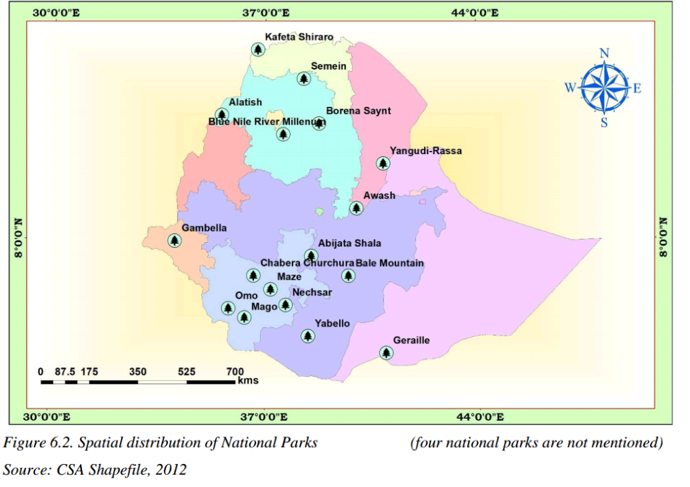

Slide 39
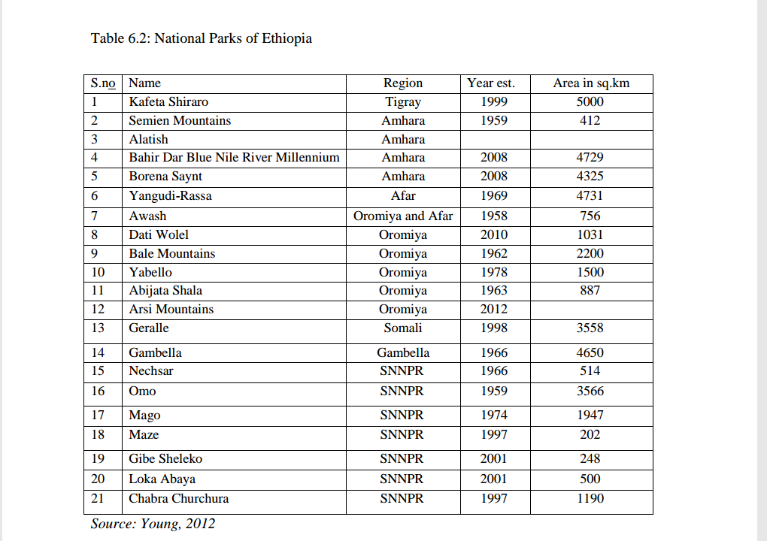

Slide 40
cont...
Some of the national parks are unique in their wild animals they have. E.g.
1. Abiyatta-Shalla lakes National Park is predominantly bird sanctuary. Important bird species include the flamingos and pelicans.
2. Omo, Mago, and Gambela National Parks have hippopotamus and crocodiles in rivers and lakes.
3. Semien and Bale Mountains National Parks have rare animals like Walia ibex, Semien fox, gelada baboon and Nyala.

Slide 41
Challenges of wildlife conservation in Ethiopia
Conservation of Ethiopia’s biodiversity and ecosystems is vital to ensure sustainable development, to mitigate and adapt to the effects of climate change and to prevent the collapse of life-supporting ecosystem services. Protected areas were created to protect the major biodiversity. However, it is a sad fact that these ecologically fundamental resources are usually undervalued and are under threat from various dimensions. Here are some of the major challenges that Ethiopian protected areas are facing;
Limited awareness on the importance of wild life
Expansion of human settlement in protected areas.
➲ Conflict over resource
➲ Overgrazing (fodder and wood)
➲ Illegal wildlife trade
➲ Excessive hunting
➲ Tourism and recreational pressure
➲ Mining and construction material extraction
➲ Forest fire.

Slide 42
THANK YOU.

